Slide 1
HUMAN BODY-VITAL SIGN MONITORING USING SMART VEST
STRICTLY_NO_ENGLISH
TEAM MEMBERS:
[DEEPIKA PALANIAPPAN]
[ROHITH RAVINDRAN]
[E. SARAH RAJKUMAR]
[SHRUTHI RAVINARAYANAN]

Slide 2
TEAM INTRODUCTION:
NAME | EDUCATION | PROJECTS (currently working on) | INTERNSHIP
Deepika Palaniappan | MTech (Big Data Analytics) | Location Recommendation System | Cognizant
Rohith Ravindran | MTech (Big Data Analytics) | Rapid Screening of chest x-ray for Tuberculosis using Deep Learning | NIL
E. Sarah Rajkumar | MTech (Big Data Analytics) | Classification of hyper spectral image using CNN
Shruthi Ravinarayanan | MTech (Big Data Analytics) | Smart Grid power sharing using block chain | L and T InfoTech

Slide 3
ABSTRACT:
An Engineer is a person who is always keen and interested in providing best alternative solution to any social problem. Keeping this mindset and visualizing the problems in healthcare domain for the masses in many countries, it is observed that annually several people die due to ignorance of their body vital signs. By identifying this problem, we suggest a wearable health device design to monitor the basic vital signs.

Slide 4
PROBLEM STATEMENT:
Vital signs are an important component of patient care. They determine which treatment protocols to follow, provide critical information needed to make life-saving decisions.
Regular monitoring can help find potential health issues before they become a problem. When you do so regularly, it is possible to detect abnormal variations in our vitals at an earlier stage. By getting the correct health screenings and treatment you are taking important steps toward living a longer, healthier life.
But to be more realistic, people only go consult a doctor when they are being faced with any illness. Else they use various devices to check each vital signs separately.

Slide 5
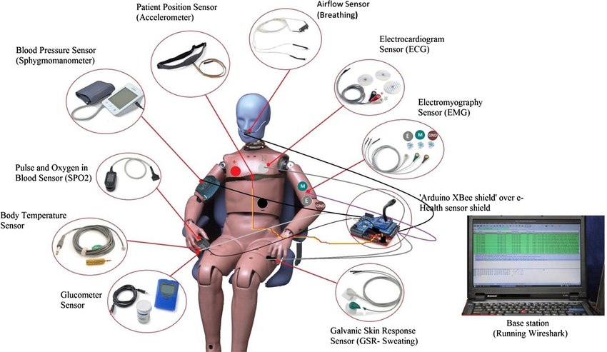
BASIC VITAL SIGNS:
Heart rate
Respiratory rate
Blood Pressure
Body Temperature
Skin Perspiration
Blood Oxygen Saturation

Slide 6
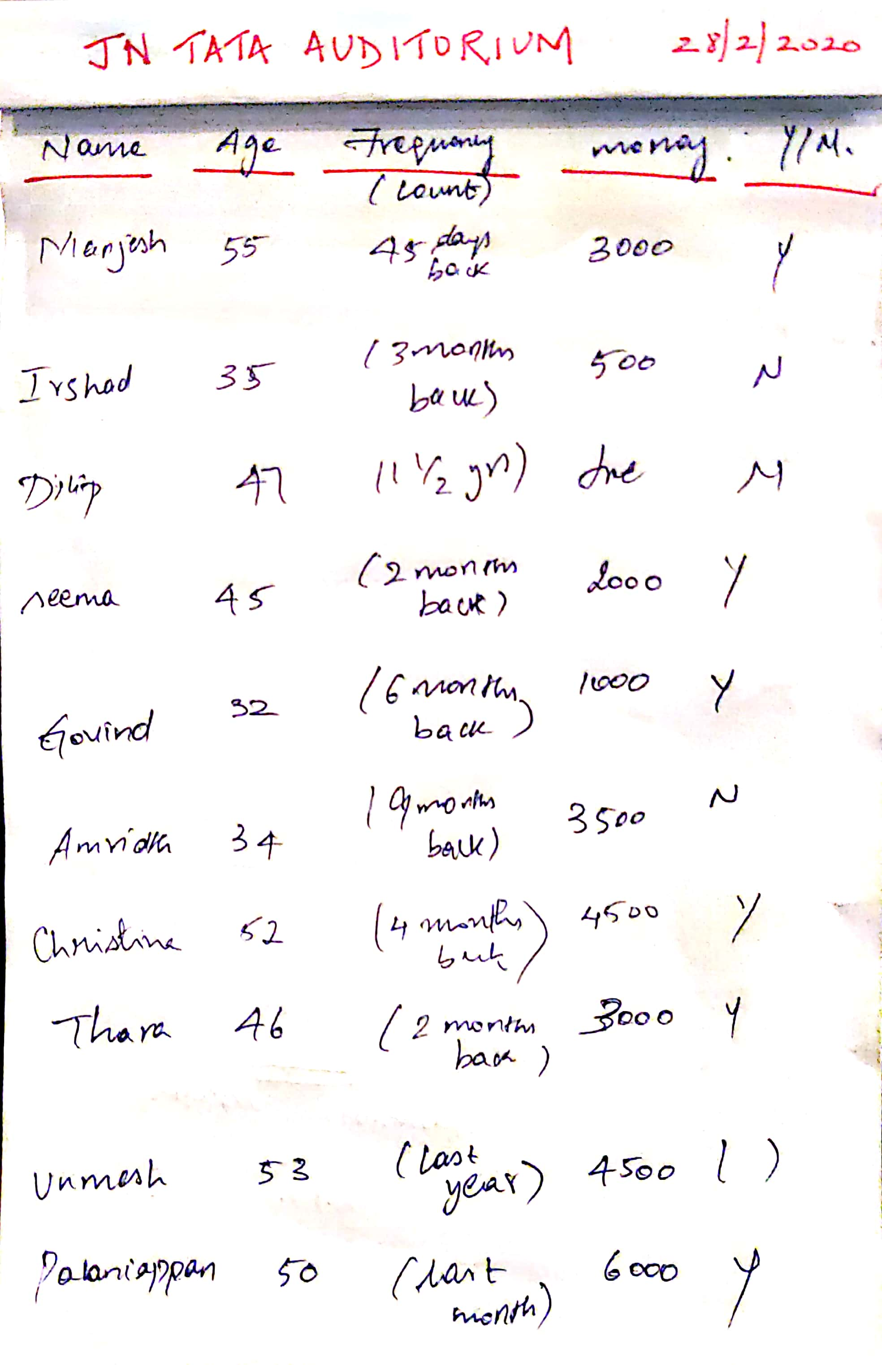
SURVEY:
This is our small survey that we conducted inside the college premises among the mentors and elders.
We observed that people go for health check-up after long gaps or only if there is an urgent need.
Based on the survey we realised that people invest a huge amount of their money to find out basic health care information about themselves i.e. the vital signs.
Instead our approach is to enable people to monitor their health status from his own place.

Slide 7
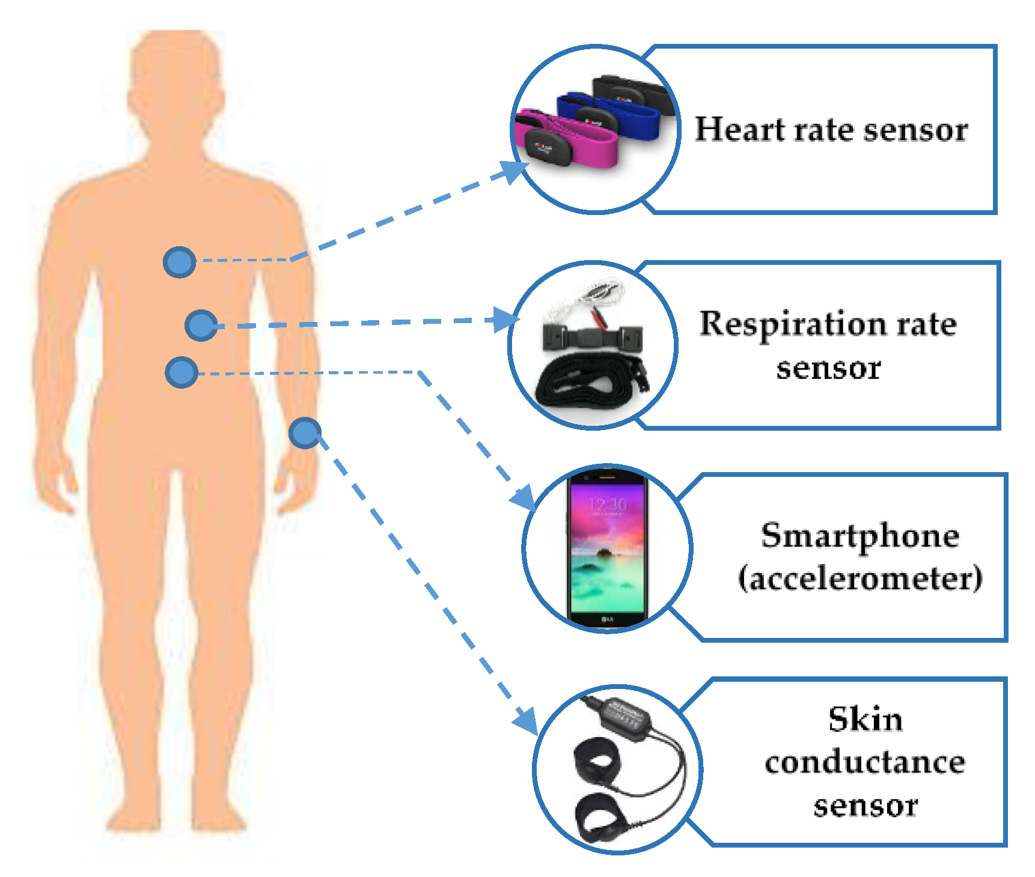
INFERENCE:
From the above survey we inferred that people check their vital signs through several device .
Example:
Parameter | Device | Cost(approx.)
Heart Rate | Blood Heart Rate Monitor | RS.3014
Respiratory Rate | Respirometer | RS. 640
Blood Pressure | Omron Hem 7130 Bp Monitor | RS.2,278
Body Temperature | Thermometer | RS.225
Skin Perspiration | Perspiration Device(“Sensirion wearable development”) | RS.2000
Blood Oxygen Saturation | Pulse Oximeter | RS.1000(min)
 | TOTAL(APPROX.) | RS.9157

Slide 8
SENSORS:
Estimated pitch value based on our survey and comparison with the rate of the available devices
Parameter | Sensor | Cost (Approx.)
Heart Rate | Electrocardiography | RS.557
Respiratory Rate | Respiratory inductive plethysmography (RIP) | RS.2010
Blood Pressure | Photoplethysmography(PPG) Sensor | RS.300
Body Temperature | MAX30205(digital thermometer temperature sensor ) | RS.795
Skin Perspiration | Perspiration Device(“Sensirion wearable development”) | RS.2000
Blood Oxygen Saturation | Pulse Oximeter | RS.1000(min)
 | TOTAL(APPROX.) | RS.6662

Slide 9
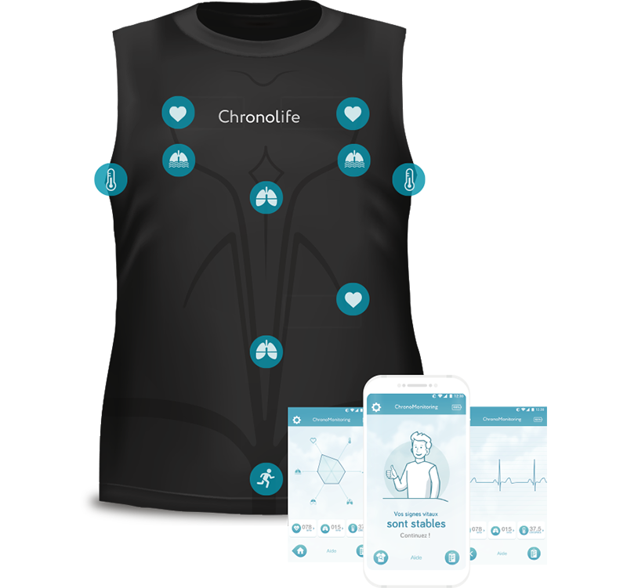
CONCLUSION:
What if all the sensors are connected together to check your body?
So here comes a smart vest were you can check all your vital signs in a single device.
Whenever you feel like your body undergoes some variations you can check your health vital signs using a single vest.
If you feel changes from normal vital signs you can then consult doctor with your basic report of monitored vital signs.

Slide 10
SAMPLE WORK COMPONENT:
TYPE OF DISEASE | WORK THAT SENSOR WILL DO | PARAMETERS CONSIDERED | ALGORITHM | ACCURACY
Diabetes | Based on the Blood Pressure(BP) change the sensor detects the type of diabetic. | Blood Pressure Glucose Age Pregnancy (in case of female) | Logistic Regression XGBoost Adaboost Decision Tree Random Forest Naive Bayes | 82% 79.8% 80.51% 72.72% 79.22% 77.27%

Slide 11
Thank you

